Slide 1

Matrices
إعداد :
فراس سمير سليم
محمد غسان القنبر

Slide 2
Performing Matrix Multiplication
AB
For this multiplication to work these matrices must have specific dimensions
(not necessarily identical)

Slide 3
Performing Matrix Multiplication
AB
For this multiplication to work A must have the same number of columns as B has rows

Slide 4
Performing Matrix Multiplication
AB
For this multiplication to work A must have the same number of columns as B has rows
A = m × n
B = q × p
n must equal q

Slide 5
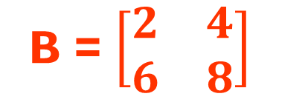
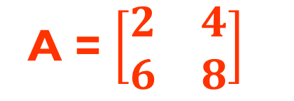
Performing Matrix Multiplication
A = $\left[\begin{matrix}2 & 4 \\ 6 & 8\end{matrix}\right]$
B = $\left[\begin{matrix}2 & 4 \\ 6 & 8\end{matrix}\right]$

Slide 6
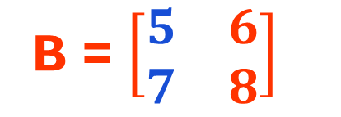
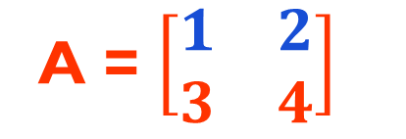


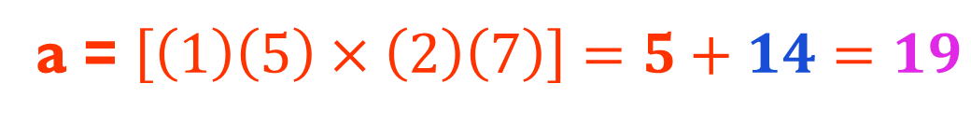
Performing Matrix Multiplication
A = $\left[\begin{matrix}1 & 2 \\ 3 & 4\end{matrix}\right]$
B = $\left[\begin{matrix}5 & 6 \\ 7 & 8\end{matrix}\right]$
a = $\left[\left(1\right)\left(5\right)×\left(2\right)\left(7\right)\right]=5+14=19$
AB = $\left[\begin{matrix}a & b \\ c & d\end{matrix}\right]$
AB = $\left[\begin{matrix}19 & b \\ c & d\end{matrix}\right]$

Slide 7
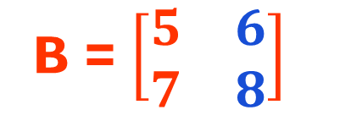
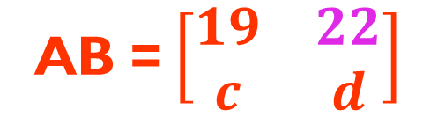

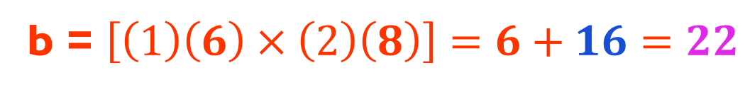
Performing Matrix Multiplication
A = $\left[\begin{matrix}1 & 2 \\ 3 & 4\end{matrix}\right]$
B = $\left[\begin{matrix}5 & 6 \\ 7 & 8\end{matrix}\right]$
b = $\left[\left(1\right)\left(6\right)×\left(2\right)\left(8\right)\right]=6+16=22$
AB = $\left[\begin{matrix}a & b \\ c & d\end{matrix}\right]$
AB = $\left[\begin{matrix}19 & 22 \\ c & d\end{matrix}\right]$

Slide 8
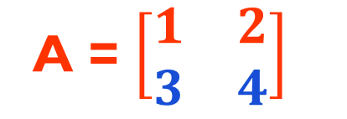
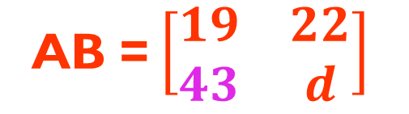

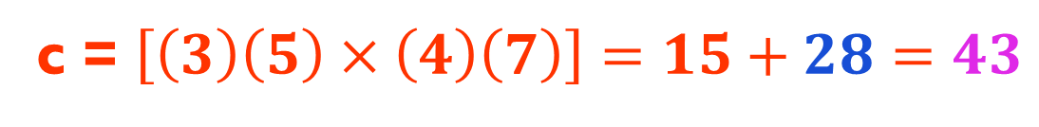
Performing Matrix Multiplication
A = $\left[\begin{matrix}1 & 2 \\ 3 & 4\end{matrix}\right]$
B = $\left[\begin{matrix}5 & 6 \\ 7 & 8\end{matrix}\right]$
c = $\left[\left(3\right)\left(5\right)×\left(4\right)\left(7\right)\right]=15+28=43$
AB = $\left[\begin{matrix}a & b \\ c & d\end{matrix}\right]$
AB = $\left[\begin{matrix}19 & 22 \\ 43 & d\end{matrix}\right]$

Slide 9


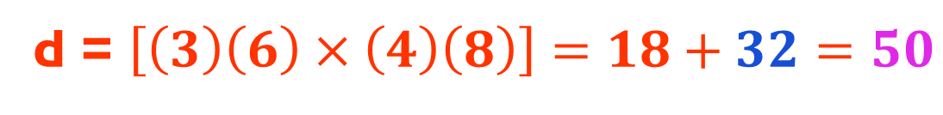
Performing Matrix Multiplication
A = $\left[\begin{matrix}1 & 2 \\ 3 & 4\end{matrix}\right]$
B = $\left[\begin{matrix}5 & 6 \\ 7 & 8\end{matrix}\right]$
d = $\left[\left(3\right)\left(6\right)×\left(4\right)\left(8\right)\right]=18+32=50$
AB = $\left[\begin{matrix}a & b \\ c & d\end{matrix}\right]$
AB = $\left[\begin{matrix}19 & 22 \\ 43 & 50\end{matrix}\right]$

Slide 10
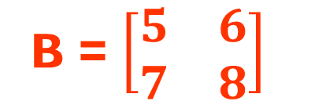
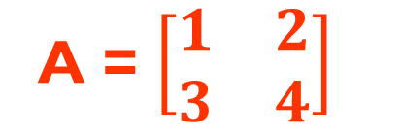

Performing Matrix Multiplication
A = $\left[\begin{matrix}1 & 2 \\ 3 & 4\end{matrix}\right]$
B = $\left[\begin{matrix}5 & 6 \\ 7 & 8\end{matrix}\right]$
This is the algorithm for matrix multiplication
AB = $\left[\begin{matrix}19 & 22 \\ 43 & 50\end{matrix}\right]$

Slide 11
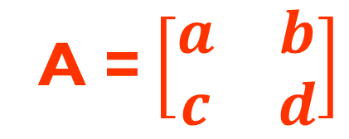
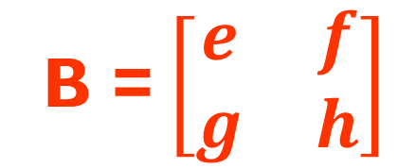
Performing Matrix Multiplication
A = $\left[\begin{matrix}a & b \\ c & d\end{matrix}\right]$
B = $\left[\begin{matrix}e & f \\ g & h\end{matrix}\right]$
This is the algorithm for matrix multiplication
AB = $\left[\begin{matrix}19 & 22 \\ 43 & 50\end{matrix}\right]$

Slide 12
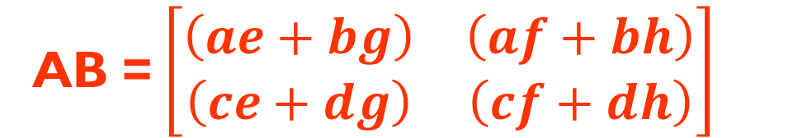
Performing Matrix Multiplication
A = $\left[\begin{matrix}a & b \\ c & d\end{matrix}\right]$
B = $\left[\begin{matrix}e & f \\ g & h\end{matrix}\right]$
This is the algorithm for matrix multiplication
AB = $\left[\begin{matrix}\left(ae+bg\right) & \left(af+bh\right) \\ \left(ce+dg\right) & \left(cf+dh\right)\end{matrix}\right]$

Slide 13
Performing Matrix Multiplication
A = $\left[\begin{matrix}a & b \\ c & d\end{matrix}\right]$
B = $\left[\begin{matrix}e & f \\ g & h\end{matrix}\right]$
Columns in A must equal rows in B
AB = $\left[\begin{matrix}\left(ae+bg\right) & \left(af+bh\right) \\ \left(ce+dg\right) & \left(cf+dh\right)\end{matrix}\right]$

Slide 14


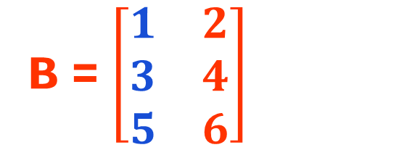
Performing Matrix Multiplication
B = $\left[\begin{matrix}1 & 2 \\ 3 & 4 \\ 5 & 6\end{matrix}\right]$
A = $\left[\begin{matrix}1 & 2 & 3 \\ 4 & 5 & 6\end{matrix}\right]$
1 + 6 + 15 = 22
AB = $\left[\begin{matrix}22 & \\ & \end{matrix}\right]$

Slide 15

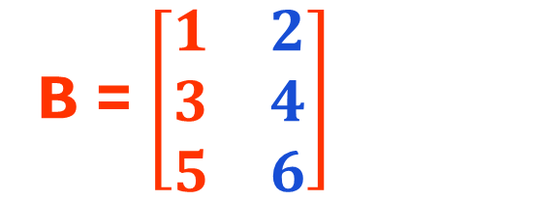
Performing Matrix Multiplication
B = $\left[\begin{matrix}1 & 2 \\ 3 & 4 \\ 5 & 6\end{matrix}\right]$
A = $\left[\begin{matrix}1 & 2 & 3 \\ 4 & 5 & 6\end{matrix}\right]$
2 + 8 + 18 = 28
AB = $\left[\begin{matrix}22 & 28 \\ & \end{matrix}\right]$

Slide 16


Performing Matrix Multiplication
B = $\left[\begin{matrix}1 & 2 \\ 3 & 4 \\ 5 & 6\end{matrix}\right]$
A = $\left[\begin{matrix}1 & 2 & 3 \\ 4 & 5 & 6\end{matrix}\right]$
4 + 15 + 30 = 49
AB = $\left[\begin{matrix}22 & 28 \\ 49 & \end{matrix}\right]$

Slide 17
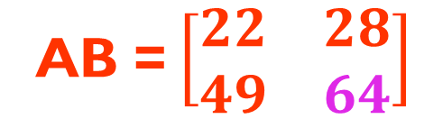
Performing Matrix Multiplication
B = $\left[\begin{matrix}1 & 2 \\ 3 & 4 \\ 5 & 6\end{matrix}\right]$
A = $\left[\begin{matrix}1 & 2 & 3 \\ 4 & 5 & 6\end{matrix}\right]$
8 + 20 + 36 = 64
AB = $\left[\begin{matrix}22 & 28 \\ 49 & 64\end{matrix}\right]$

Slide 18

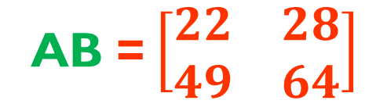
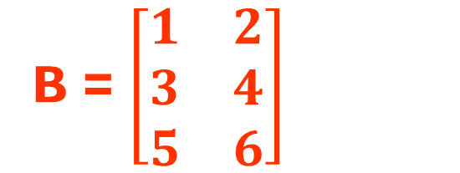
Performing Matrix Multiplication
B = $\left[\begin{matrix}1 & 2 \\ 3 & 4 \\ 5 & 6\end{matrix}\right]$
A = $\left[\begin{matrix}1 & 2 & 3 \\ 4 & 5 & 6\end{matrix}\right]$
The product is a 2 × 2 matrix
AB = $\left[\begin{matrix}22 & 28 \\ 49 & 64\end{matrix}\right]$

Slide 19
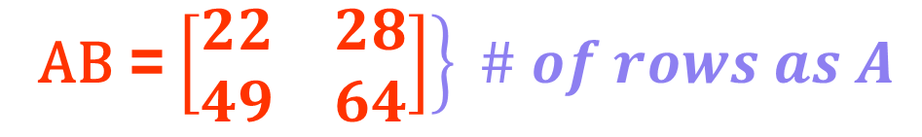

Performing Matrix Multiplication
B = $\left[\begin{matrix}1 & 2 \\ 3 & 4 \\ 5 & 6\end{matrix}\right]$
A = $\left[\begin{matrix}1 & 2 & 3 \\ 4 & 5 & 6\end{matrix}\right]$
$$\# of columns as B$$
AB = $\left.\left[\begin{matrix}22 & 28 \\ 49 & 64\end{matrix}\right]\right\} \# of rows as A$

Slide 20
Performing Matrix Multiplication
B = $\left[\begin{matrix}1 & 2 \\ 3 & 4 \\ 5 & 6\end{matrix}\right]$
A = $\left[\begin{matrix}1 & 2 & 3 \\ 4 & 5 & 6\end{matrix}\right]$
Number multiplication is commutative
ab = ba
matrix multiplication is NOT commutative
AB ≠ BA

Slide 21
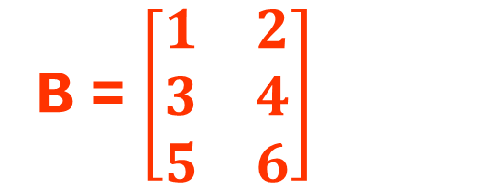

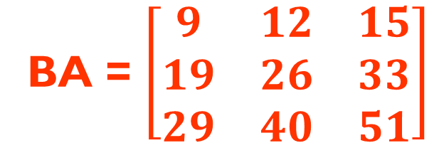
Performing Matrix Multiplication
B = $\left[\begin{matrix}1 & 2 \\ 3 & 4 \\ 5 & 6\end{matrix}\right]$
A = $\left[\begin{matrix}1 & 2 & 3 \\ 4 & 5 & 6\end{matrix}\right]$
BA = $\left[\begin{matrix}9 & 12 & 15 \\ 19 & 26 & 33 \\ 29 & 40 & 51\end{matrix}\right]$

Slide 22

Performing Matrix Multiplication
B = $\left[\begin{matrix}1 & 2 \\ 3 & 4 \\ 5 & 6\end{matrix}\right]$
A = $\left[\begin{matrix}1 & 2 & 3 \\ 4 & 5 & 6\end{matrix}\right]$
3 columns
BA = $\left[\begin{matrix}9 & 12 & 15 \\ 19 & 26 & 33 \\ 29 & 40 & 51\end{matrix}\right]$
3 rows

Slide 23
Performing Matrix Multiplication
matrix multiplication is NOT commutative
AB ≠ BA
matrix multiplication is associative
(AB)C = A(BC)
matrix multiplication can be distributive
If A and B are m×n matrices and C and D are n×p matrices
A(C + D) = AC + AD and (A + B)C = AC + BC

Slide 24
Performing Matrix Multiplication
A = $\left[\begin{matrix}a & b \\ c & d\end{matrix}\right]$
B = $\left[\begin{matrix}e & f \\ g & h\end{matrix}\right]$
This is the algorithm for matrix multiplication
AB = $\left[\begin{matrix}\left(ae+bg\right) & \left(af+bh\right) \\ \left(ce+dg\right) & \left(cf+dh\right)\end{matrix}\right]$

Slide 25
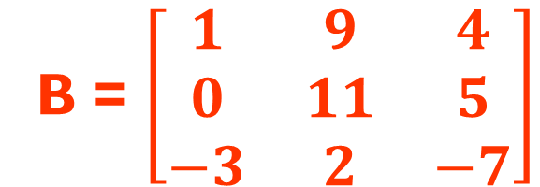
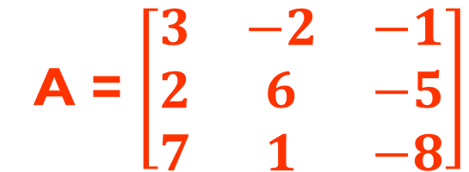
Checking Comprehension
A = $\left[\begin{matrix}3 & −2 & −1 \\ 2 & 6 & −5 \\ 7 & 1 & −8\end{matrix}\right]$
B = $\left[\begin{matrix}1 & 9 & 4 \\ 0 & 11 & 5 \\ −3 & 2 & −7\end{matrix}\right]$
Find AB:
Find BA :

Slide 26
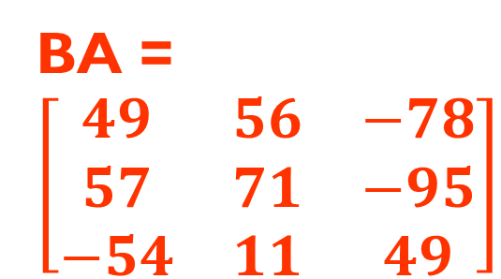
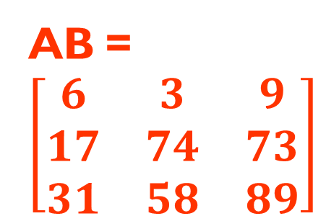
Checking Comprehension
A = $\left[\begin{matrix}3 & −2 & −1 \\ 2 & 6 & −5 \\ 7 & 1 & −8\end{matrix}\right]$
B = $\left[\begin{matrix}1 & 9 & 4 \\ 0 & 11 & 5 \\ −3 & 2 & −7\end{matrix}\right]$
Find AB:
Find BA :
AB= $\left[\begin{matrix}6 & 3 & 9 \\ 17 & 74 & 73 \\ 31 & 58 & 89\end{matrix}\right]$
BA = $\left[\begin{matrix}49 & 56 & −78 \\ 57 & 71 & −95 \\ −54 & 11 & 49\end{matrix}\right]$

